Slide 1


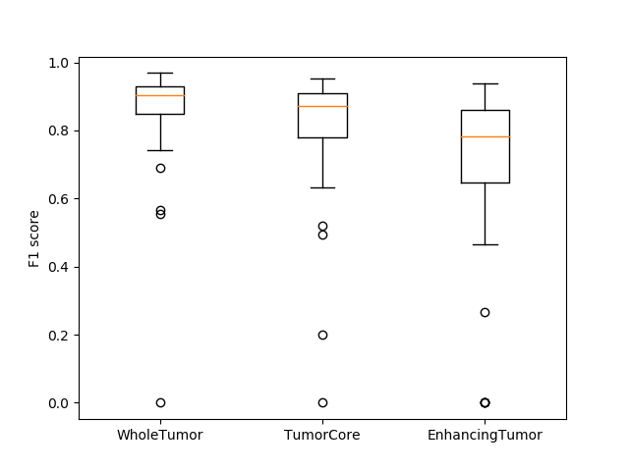
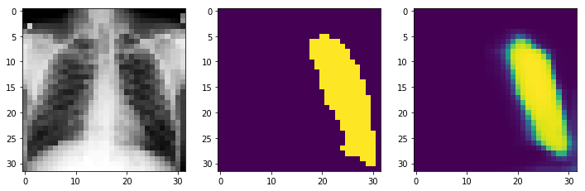
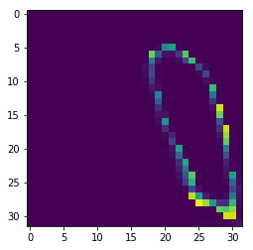
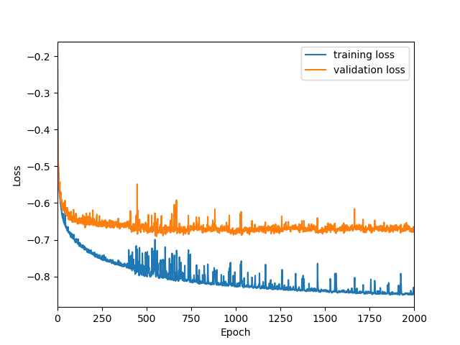

Enhancing Positron-Emission Tomography Images with Deep Learning Methods
By: Ariel Leach, Russell McLemore, Brian Thayil, and Vivian Young
Introduction
Positron emission tomography (PET) is a medical imaging process that utilizes radiation. Increased radiation results in higher resolution images that help identify abnormalities such as cancerous tumors. However, high doses of radiation can be dangerous to the patient’s health and safety. This project aims to detect abnormalities in PET images with low-dose radiation. It is achieved through the usage of deep learning artificial intelligence for medical image processing.
Processes
Images: medical images to be used as input for the software
Pre-Processing: manual identification of desired areas for truth image
Noise Generation: Poisson or Gaussian noise artificially applied to images to test program’s effectiveness
Segmentation: down-sampling and up-sampling of U-Net
Training: AI used to generate a model to be applied to images
Output: generated prediction image and the accuracy/error
2D U-Net:
3D U-Net:
Results
Using sample MRI 3D brain scan data, the team was able to achieve 90% accuracy with the Whole Tumor with 39.44 hours of training, using a GeForce RTX 2080 Ti Graphics Card. This program can be applied to other data sets like PET images to get similar results.
Pre-
Processing
Noise
Generation
Segmentation → Training → Output
Images →
→
→
F1 (Accuracy) Scores
Objective
The program shall enhance PET images to the resolution of a full dose medical image to the following standards:
Input
Prediction
Truth
Error
Accuracy | Training Time
90% | < 96 hours
80% | < 48 hours
70% | < 24 hours
Loss
Input
Prediction
Truth
Design
Convolutional Neural Network (CNN):
A deep learning algorithm that can take in an input image and classify it by assigning importance to different aspects of the image
U-Net:
Roadblocks
Even with top, high-performing GPUs, training can be a lengthy process that takes days to complete, so the team was under heavy time constraints
There are legal processes that the UT Southwestern’s Medical Center's Department of Radiology must undergo in order to gain access and make use of de-identified research subject data, so the team was not able to input clinical data for the project
A type of CNN that can successively down-sample and up-sample an image for segmentation and prediction purposes
Project Sponsors
Dr. Liang Dong (Baylor University)
Dr. Orhan Oz (UT Southwestern Medical Center)

